Slide 1
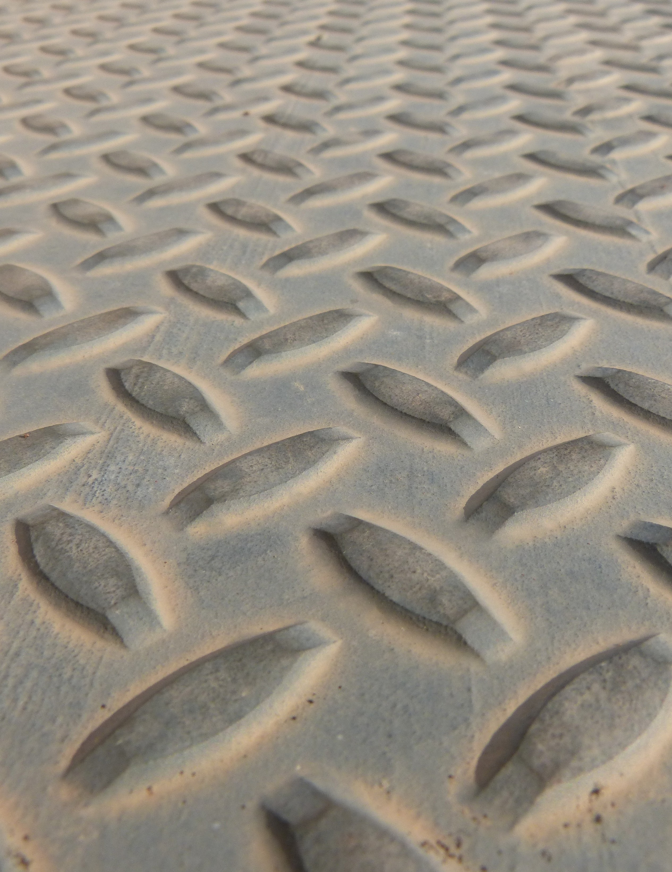


2020
CONTRACTS COMMITTEE VIRTUAL SEMINAR SERIES
V I R G I N I A S H I P R E P A I R A S S O C I A T I O N
O C T | 1 5 | E T H I C S & S T A N D A R D S O F C O N D U C T
O C T | 2 7 | O T H E R T R A N S A C T I O N A U T H O R I T I E S
N O V | 1 8 | R I S K
D E C | 1 | C O V I D I M P A C T R E C O V E R Y
V S R A Z O O M A C C O U N T 1 2 : 0 0 - 1 : 3 0 P M
Members: $20 per seminar or $60 for all four
Non-Members: $40 per seminar or $120 for all four
Questions? Contact Daniel Keats
DKeats@ Virginia Ship Repair. org | ( 757 ) 233 - 7034

Slide 2













2020
CONTRACTS COMMITTEE SEMINAR SERIES
PLEASE JOIN US IN THANKING OUR SPONSORS

